Slide 1
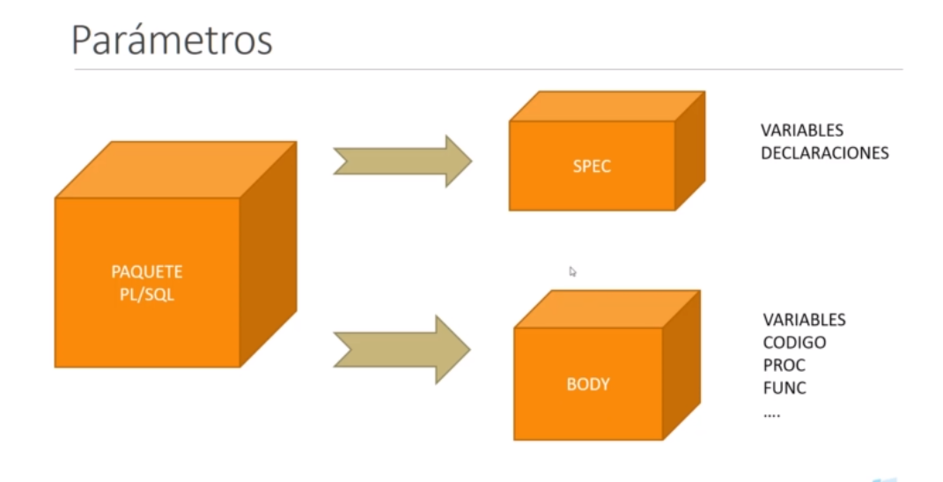

Slide 2
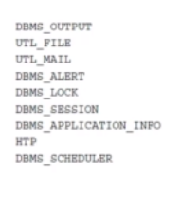
Paquetes predefinidos de Oracle
https://docs.oracle.com/database/121/ARPLS/toc.htm

